Slide 1


Indicadores Seguridad
Córdoba – ET
Junio 2008

Slide 2
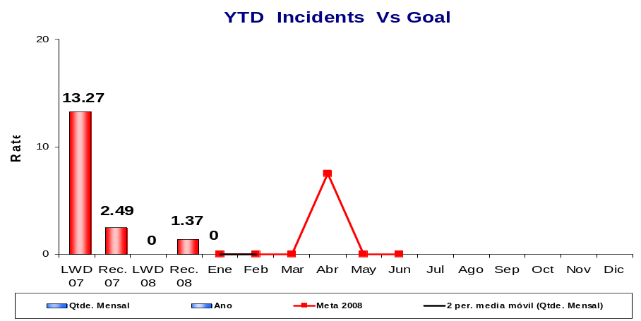
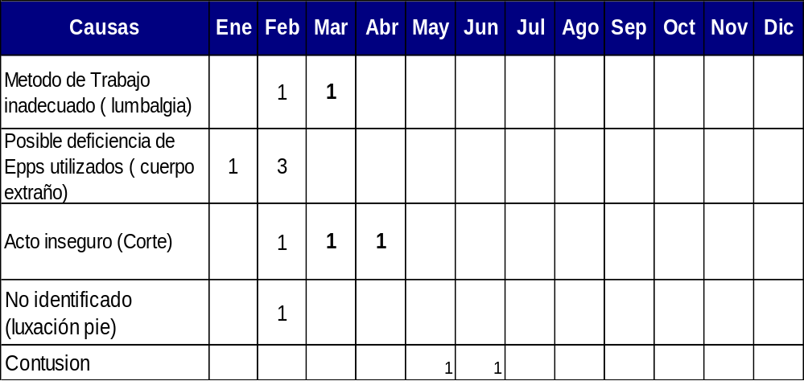
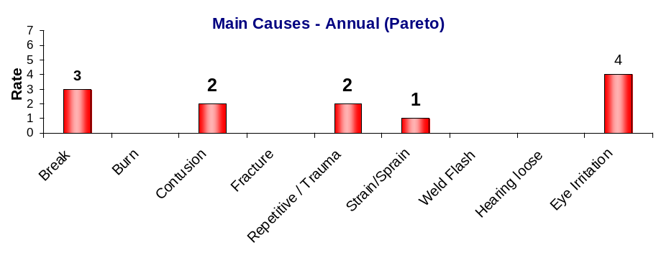
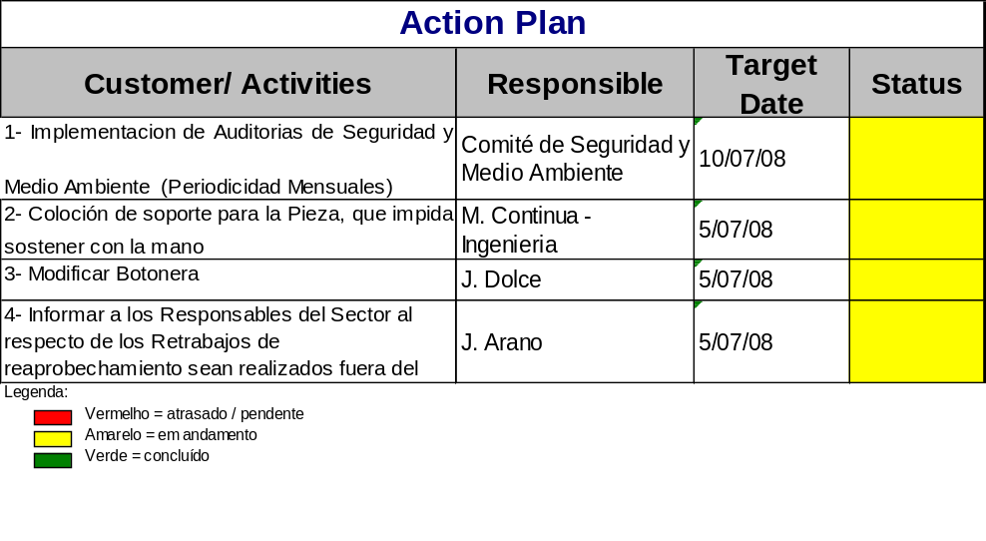
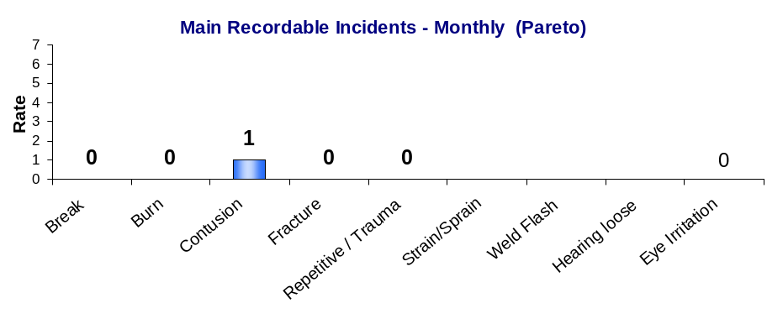
Cordoba TAXA DE TOTAL DE ACIDESTES REPORTADOS
(Tipo B e C) (Total Case Rate)
Metas
LWD Meta 2008: 5.2
Reportables: 1.2
7.53
Bien
Dias sin accidentes con Perdida de días hasta: 31/06/08: 425 Record Anterior : 371

Slide 3
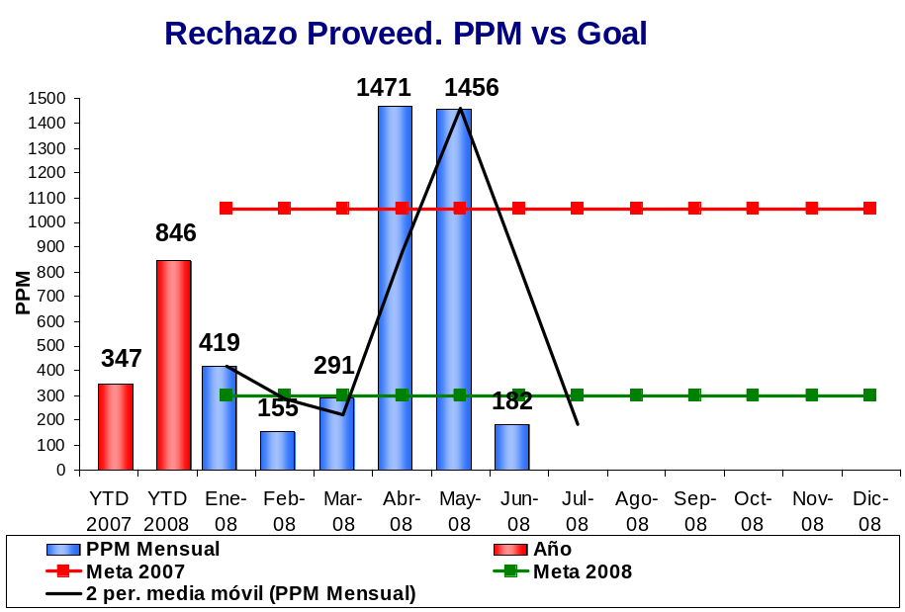
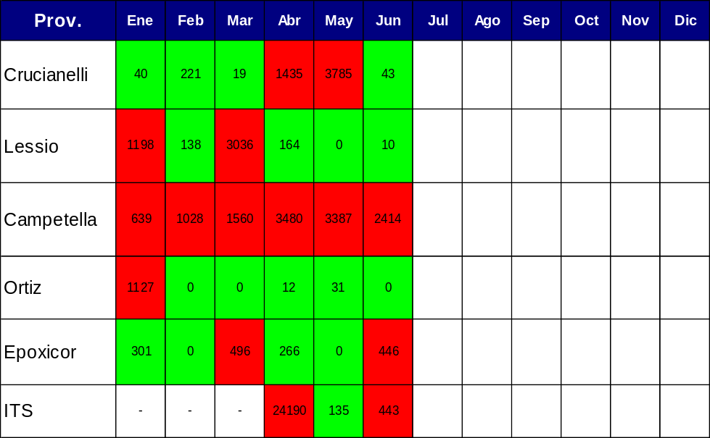
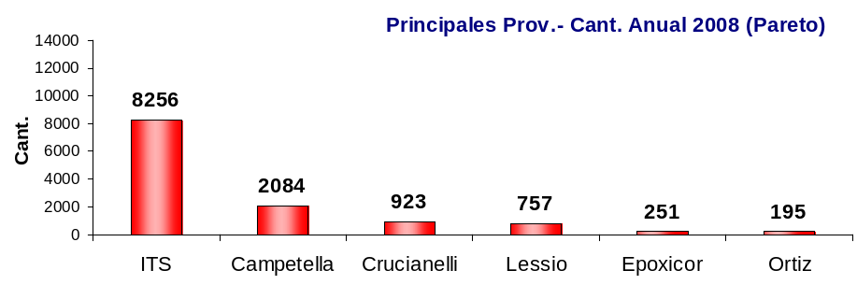
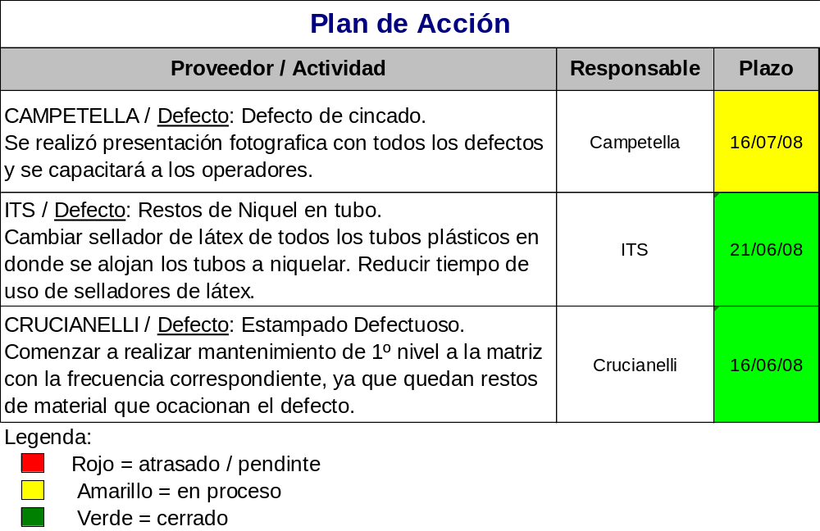
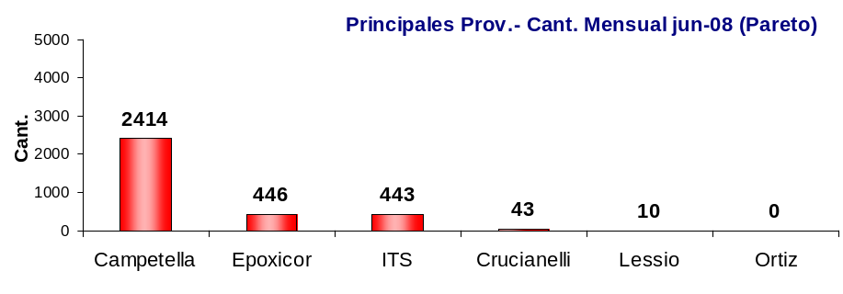
PPM DE PROVEEDOR
Seguimiento PPM principales Proveed.
Meta 2007: 1054 PPM
Meta 2008: 300 PPM

Slide 4
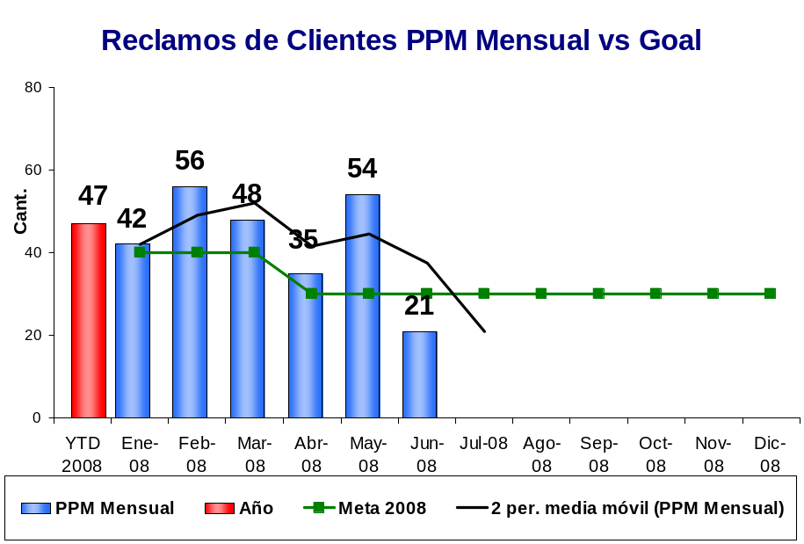
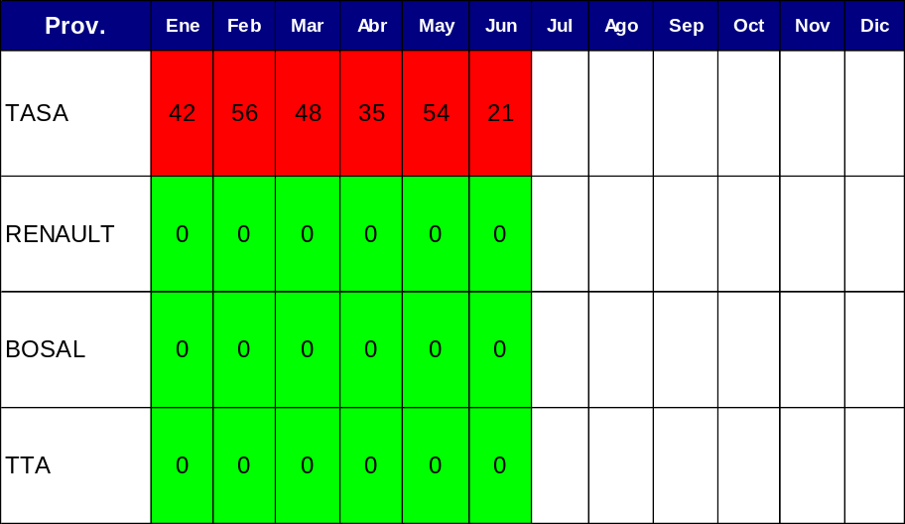
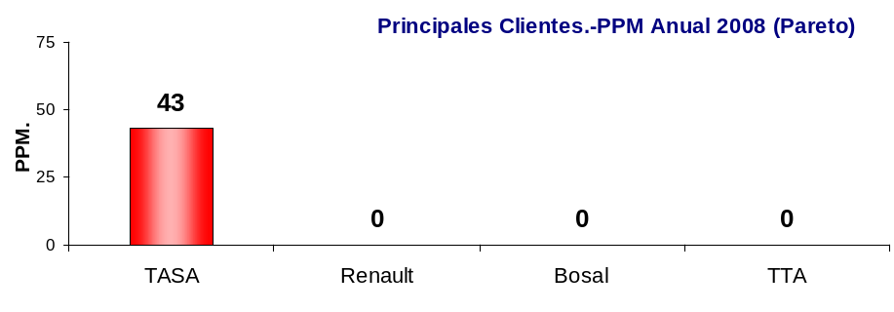
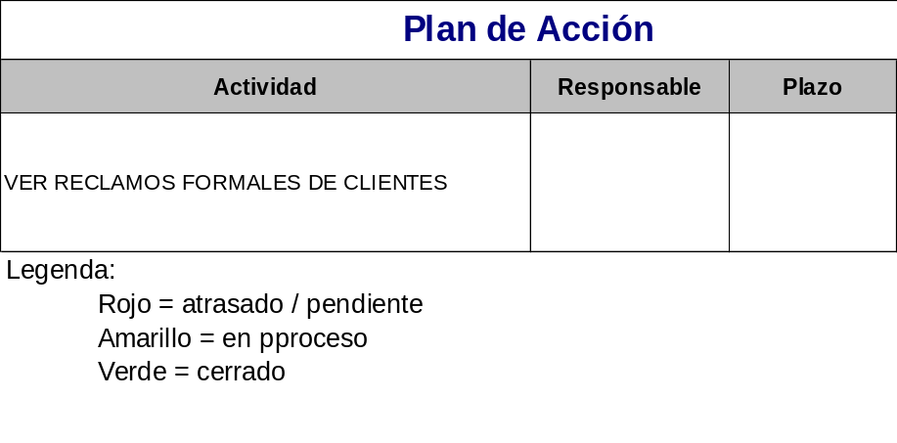
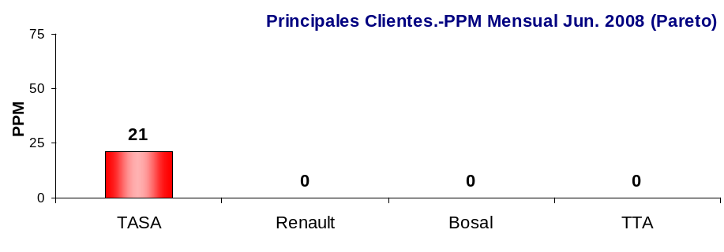
PPM FORMAL DE CLIENTES
Seguimiento PPM principales Clientes.
Meta 2008: 30 PPM

Slide 5
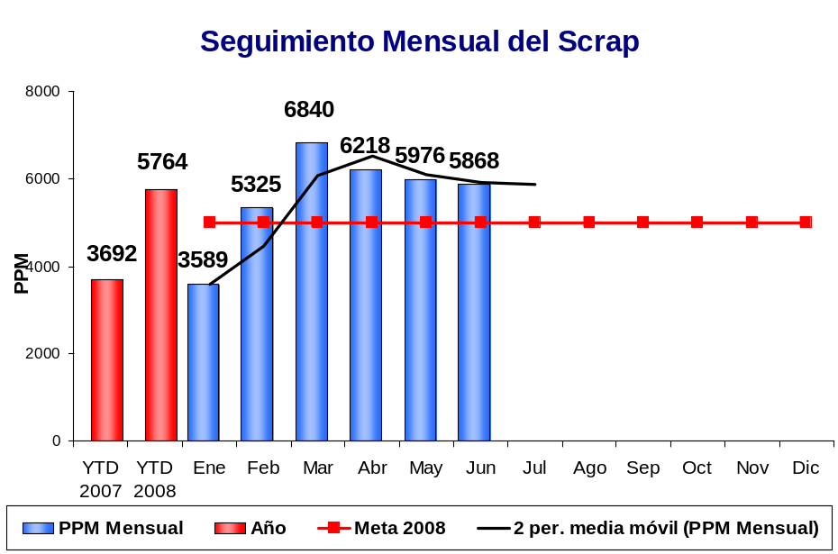
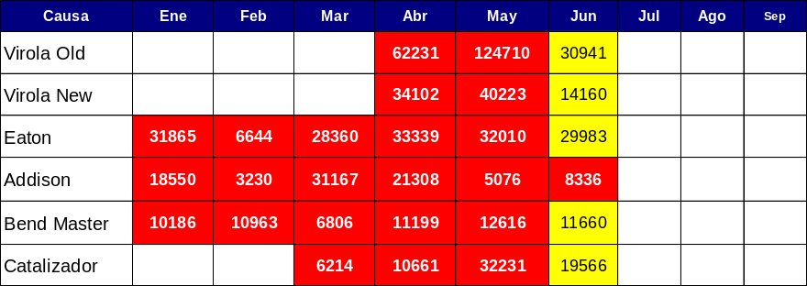
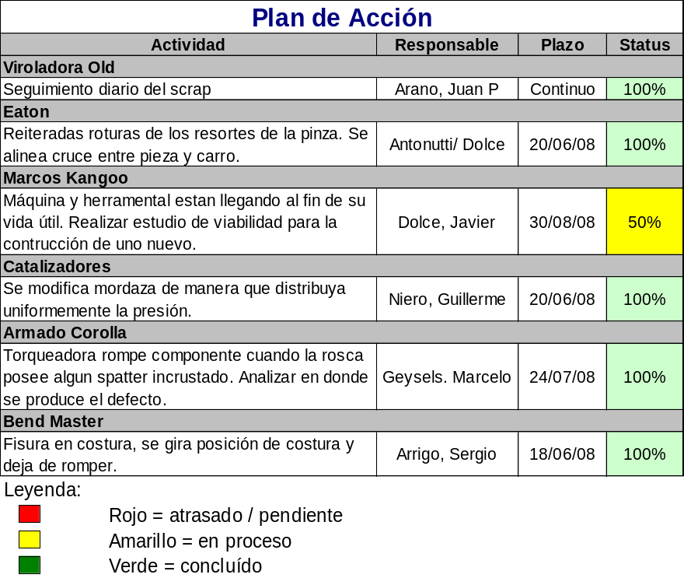
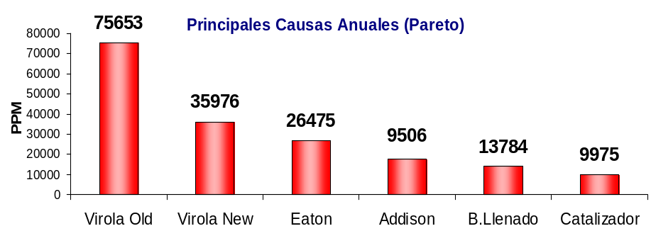
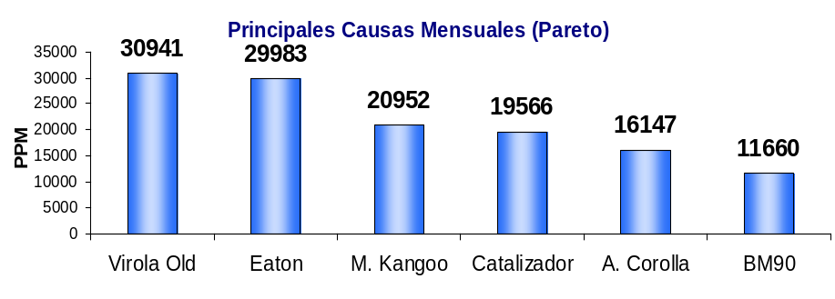
Indicador de Scrap en Planta
Seguimiento Mensual de las Causas
Meta 2008: 5000 PPM
Bueno

Slide 6
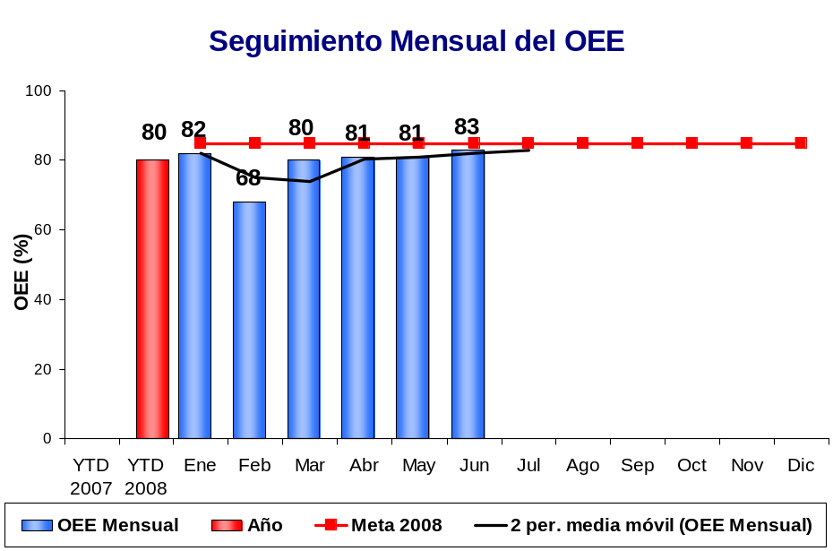
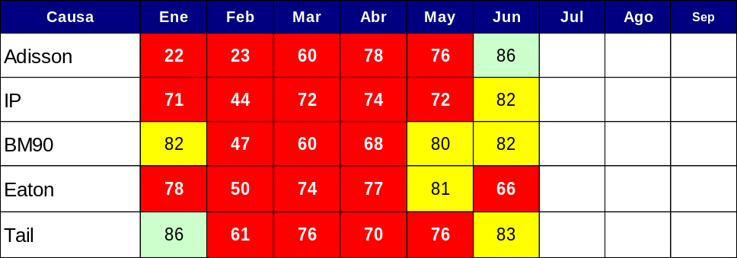
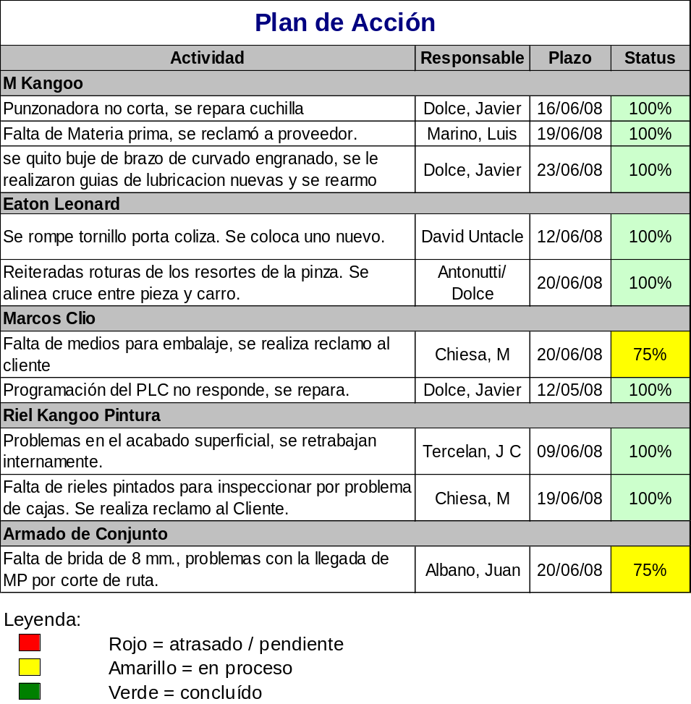
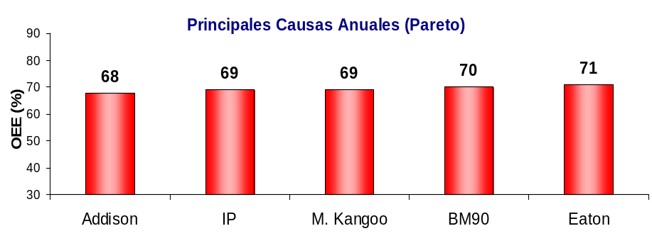
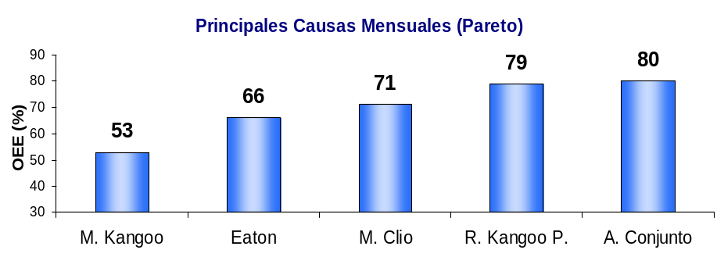
Indicador de OEE - Acumulado
Seguimiento Mensual de las Causas
Bueno
Meta: 85%
Eficiencia: 91%
Calidad: 99%
Disponibilidad: 92%

Slide 7
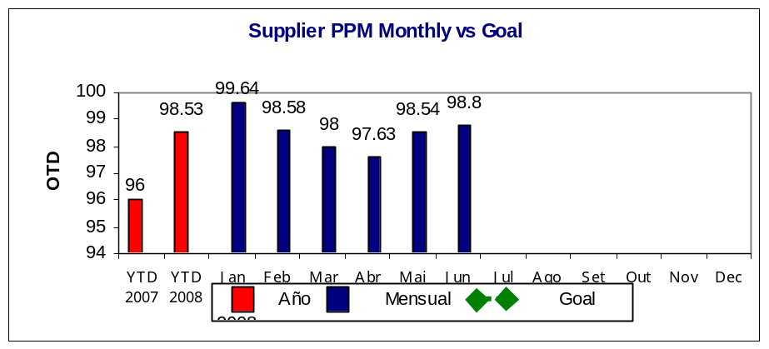
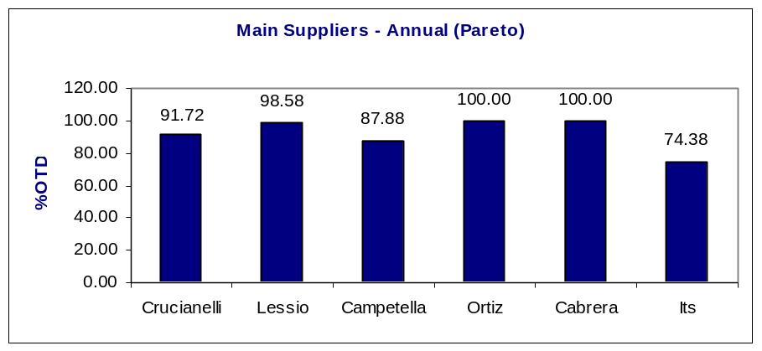
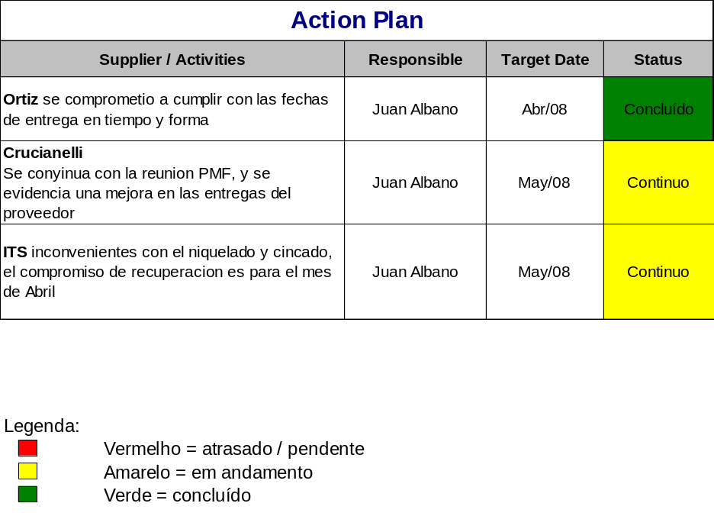
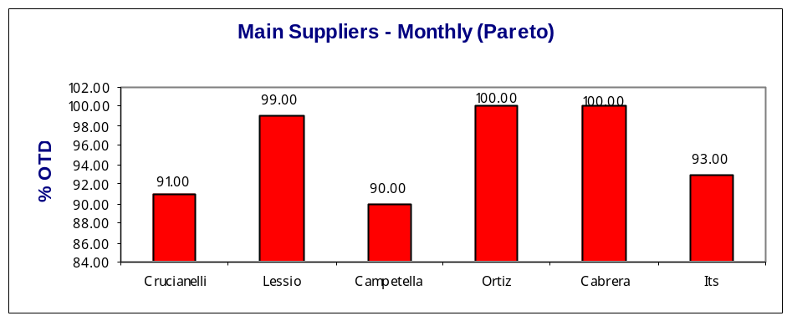
Desempeño de entrega Proveedores
(Purchases received on time)
Main Suppliers Follow-up
Causes | Jan | Feb | Mar | Abr | May | Jun | Jul
Crucianelli | 91 | 92.8 | 96.5 | 85 | 94 | 91
ITS |  |  | 47.6 | 71.9 | 85 | 93
Lessio | 100 | 100 | 100 | 93.5 | 99 | 99
Campetella | 100 | 67 | 97 | 83.3 | 90 | 90
Ortiz | 100 | 100 | 100 | 100 | 100 | 100
Cabrera | 100 | 100 | 100 | 100 | 100 | 100

Slide 8
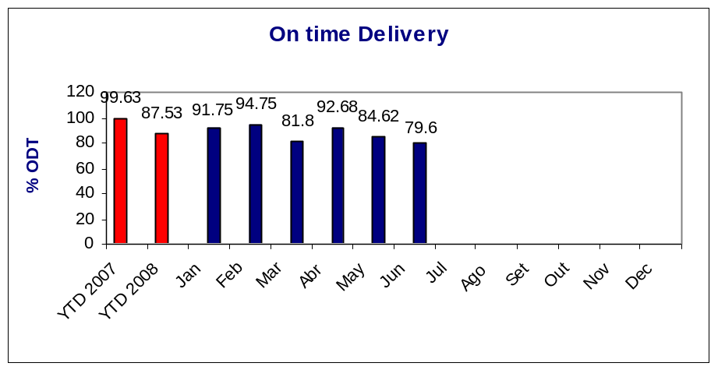
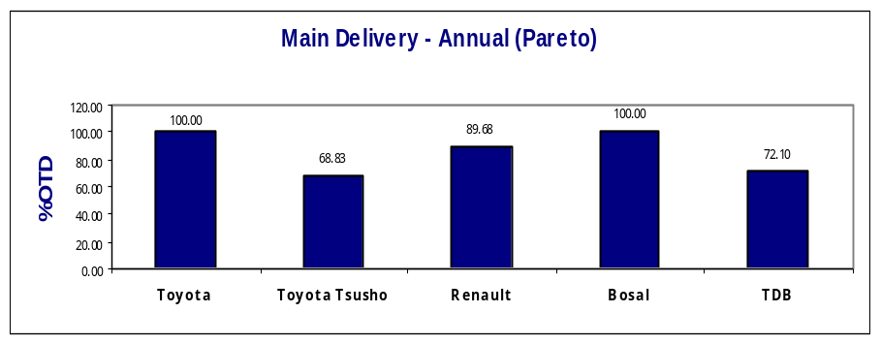
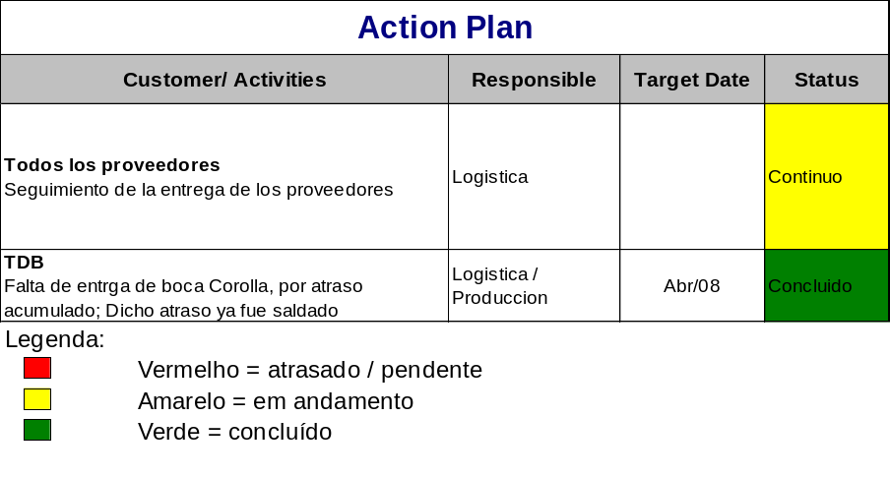
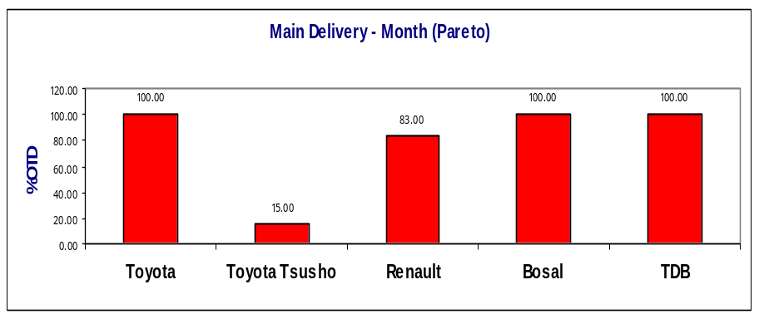
ENTREGA a CLIENTES
(On Time Delivery)
Main Customers Follow-up
Causes | Jan | Feb | Mar | Abr | May | Jun
Toyota | 100 | 100 | 100 | 100 | 100 | 100
TDB (Corolla boca larga) |  |  | 11 | 77.4 | 100 | 100
Toyota Tsusho | 67 | 81 | 100 | 100 | 50 | 15
Renault | 100 | 98 | 98 | 86 | 73.1 | 83
Bosal | 100 | 100 | 100 | 100 | 100 | 100

Slide 9
Indicadores Recursos Humanos
Córdoba – ET
Junio 2008

Slide 10
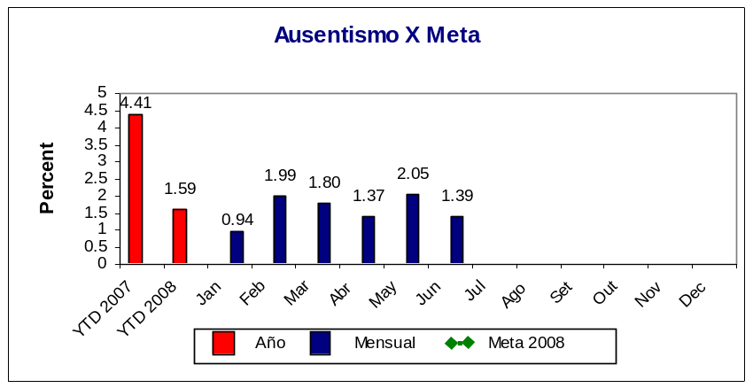
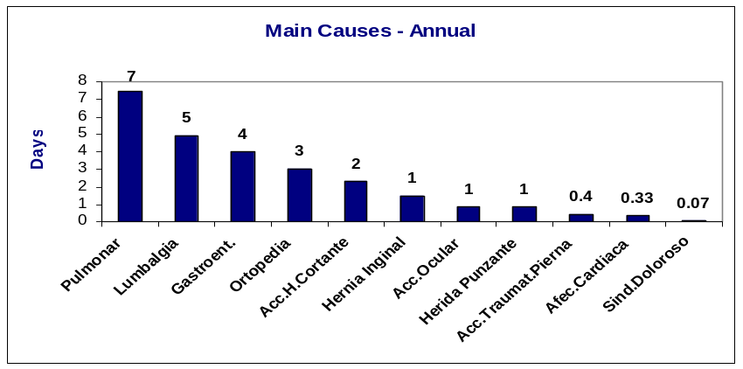
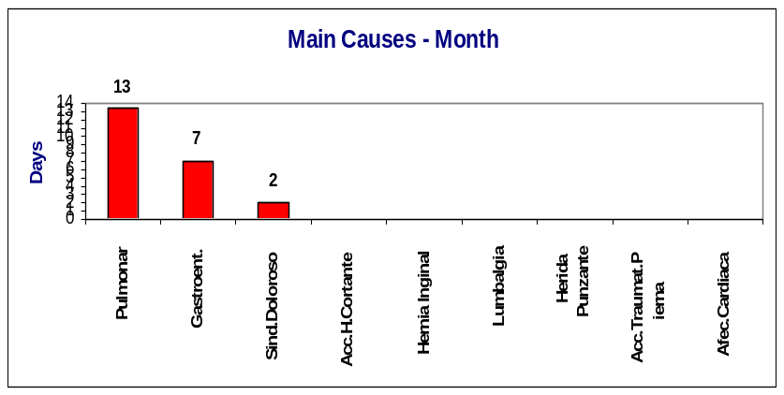
AUSENTISMO – ET CÓRDOBA, ARG
Meta 2008: 1.5 %
Meta 2007: 1.5 %
MAIN CAUSES - AUSENTISMO
Causes (Days) | Jan | Feb | Mar | Abr | May | Jun
Enf. Inculp | 18.8 | 20.0 | 29.33 | 20 | 32 | 22
Enf.Fliar | 1.25 | 0 | 7.22 | 0 | 2 | 4
Lic.Mudan | 1.00 | 1.00 | 1 | 0 | 0 | 0
Lic.Gremial | 0 | 2.00 | 0 | 5.8 | 12 | 4
Acc.Initinere | 0 | 0 | 2 | 0 | 0 | 3
Lic.Examen | 0 | 2.00 | 2 | 0 | 2 | 3
Lic.Nac. | 0 | 0 | 1 | 0 | 0 | 2
Fallec.Fliar | 0 | 2.00 | 0 | 0 | 0 | 0
Lic.Casam. | 0 | 10 | 0 | 0 | 0 | 0
Lic.Donacion S. | 0 | 1.00 | 0 | 0 | 1 | 0
Acc.Trab. | 0 | 15.23 | 8.89 | 15 | 11 | 0
Action Plan
Customer/Activities | Responsible | Target Date | Status
Status:
 | Atrasado/pendiente
 | En curso
 | Concluido

Slide 11
HEADCOUNT – ET CÓRDOBA, ARG
Category | Actual | AOP | B/(W) | AOP 2008
Direct | 83 | 72 | -11 | 72
Indirec | 32 | 26 | -6 | 26
Salary | 18 | 25 | 7 | 25
Contract Salary | 0 | 4 | 4 | 4
Total | 133 | 127 | -6 | 127
No Included in Headcount |  | Causal Explanation:
 |  | HC Increasing
Temporary (college hire) | 10 | Abr. | May | Jun | Jul
Total | 10 | MOD(5)vto.Cont.31/5 | MOD(5)Renovacion Cto.30/06 | MOD(5)Renovacion Cto.31/10
 |  | MOI (1)Pte.Finanz. | MOD (2)Mcos Clio Cto.17/7 | Pasante Calidad 17/06
Total General | 143 | MOI (1)Pte.PCP | MOD (1) Calidad 200% Cto.21/7 | Pasante IT 09/06 –Brunetti
 |  |  | MOI (1) Mtto. | MOI(1)Pañol –MOI (Barrionuevo)
 |  | Resigning
To be Hired |  | Abr. | May | Jun | Jul
 |  | MOI (1)Mtto. | MOI (1) IT | MOI(1)Mtto. MOD(Barrionuevo)
 |  | MOI (1)Calidad | MOI (1) Calidad | MOD(1)Mcos Clio Cont.

Slide 12
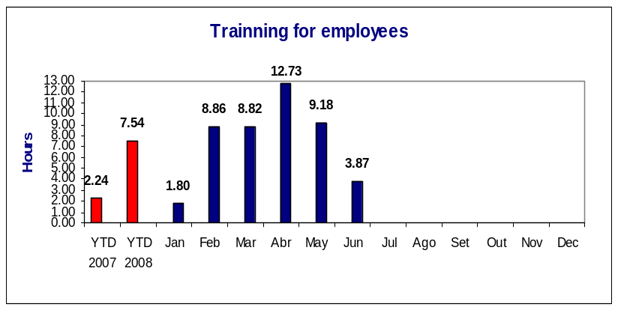
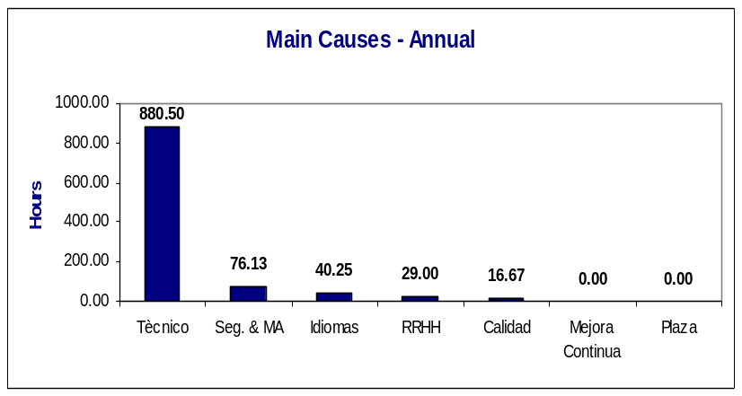
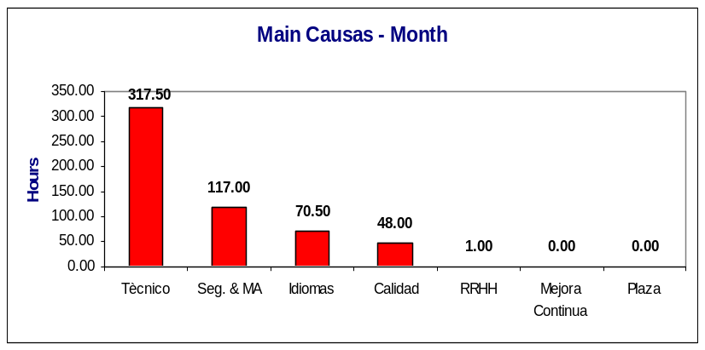
TRAINNING – ET CÓRDOBA, ARG
Main Customers Follow Up
Causes | Jan | Feb | Mar | Abr | May | Jun
Seg. & MA | 7.5 | 149 | 29.5 | 131 | 22.5 | 117
Tècnico | 222.5 | 1040 | 1136 | 1550 | 1017 | 317.5
idioma | 0 | 0 | 7.50 | 91.5 | 72 | 70.5
RRHH | 0 | 5.5 | 3 | 9 | 155.5 | 1
Calidad | 0 | 1 | 15 | 0 | 0 | 48
Meta 2008: 5.00 hs
Meta 2007: 7.00 hs
Año Mensual Meta 2008
Action Plan
Customer/Activities | Responsible | Target Date | Status
Status:
 | Atrasado/pendiente
 | En curso
 | Concluido

